Slide 1
Causal diagram Hypotheses Research design
Lecture 2.b
21 Nov 2023

Slide 2
Learning objectives module 2
Define and explain difference between
Concepts and variables
Unit of analysis and unit of observation
Propositions and hypotheses
Theories, research models and measurement models
Formulate a simple causal diagram that links a few concepts

Slide 3
Learning objectives module 3
Select a proper research design for a given research question or causal diagram
Identify disturbing effects that threaten internal validity for a given research design
Reflect on how research design allows claims on causality, internal and external validity
Select a proper data collection method for a given research design

Slide 4
What is a causal diagram?
Set of related hypotheses
Should answer the research questions
Should be motivated, preferably informed by literature review / meta-analysis
Should be on a specific unit of observation

Slide 5
What is a hypothesis?
A formal statement of some unproven supposition that tentatively explains uncertain phenomena
Causal links: not `similar to’ or `is part of’
Typically linking two or three variables

Slide 6
What is a unit of analysis?
Unit of analysis | Unit of observation
The major entity being studied | The unit described in the dataset
What the research question is about | What each data point is about
Examples: Individual, team, group, division, organization, alliance, industry, country | Examples: Individual, team, group, division, organization, alliance, industry, country

Slide 7
Causal diagram & hypotheses
Data sovereignty is important for data providers. Yet, its impact on the broader data economy is still unclear. Based on a survey from a UK representative sample (n=404), this study explores the implication of data sovereignty to four components of data economy. The findings reveal a direct positive relationship between data sovereignty and providers’ willingness to share data. Perceived risk mediates this relationship, while trust in platform operators and consumers surprisingly does not.
Make a list of key concepts of the study
Define the unit of analysis
Draw a causal diagram that links the key concepts
(Abbas et al., in preparation)

Slide 8
What is a hypothesis?
A formal statement of some unproven supposition that tentatively explains uncertain phenomena
Causal links: not `similar to’ or `is part of’
Typically linking two or three variables

Slide 9
Causal diagram & hypotheses
Data sovereignty is important for data providers. Yet, its impact on the broader data economy is still unclear. Based on a survey from a UK representative sample (n=404), this study explores the implication of data sovereignty to four components of data economy. The findings reveal a direct positive relationship between data sovereignty and providers’ willingness to share data. Perceived risk mediates this relationship, while trust in platform operators and consumers surprisingly does not.
Write down four hypotheses that link the key concepts
For each hypothesis, write down if it is directional or non-directional
For each concept, write down if they are independent variable, dependent variable, moderator or mediator
(Abbas et al., in preparation)

Slide 10
Validity: internal vs. external
Internal = to what extent does the research design permit us to say that an independent variable X causes a change in dependent variable Y?
External = To what extent can the results be generalized to a broader population or to a broader (organizational) setting?

Slide 11
Research design
Data sovereignty is important for data providers. Yet, its impact on the broader data economy is still unclear. Based on a survey from a UK representative sample (n=404), this study explores the implication of data sovereignty to four components of data economy. The findings reveal a direct positive relationship between data sovereignty and providers’ willingness to share data. Perceived risk mediates this relationship, while trust in platform operators and consumers surprisingly does not.
What research approach is selected in this paper?
What would be threats to internal validity (=causal claims) in this study?
What would be threats to external validity (=generalizability) in this study?
(Abbas et al., in preparation)

Slide 12
Causal diagram/hypotheses
Meta-platforms amplify data sovereignty concerns: the inability of data providers to control the shared data. Control mechanisms (i.e., certification, smart contract) help maintain data sovereignty. Nevertheless, the complex offerings of meta-platforms (e.g., enabling data flow from an IoT platform to others) make us question the efficacy of these control mechanisms. This study aims to evaluate the perceived efficacy of control mechanisms to maintain data sovereignty in meta-platforms. The findings from a survey study (n=93) indicate that respondents perceive high data sovereignty. Smart contracts enable providers to control the shared data; certification signals meta-platforms’ responsibility to deliver secure data-sharing infrastructure.
Draw a causal diagram that summarizes the findings of the study
(Abbas et al., 2023)

Slide 13
Research design
This study has some limitations. First, we used a one-sample t-test, which only compares results to the middle point of a rating scale. To improve the validity of the findings, we will continue this research by conducting a between-subject 2x2 experiment. In doing so, we can compare the effect of the presence of these control mechanisms and identify potential interaction effects to confirm the proposed H1 and H2. Second, while our study focuses on the most critical dimension of data sovereignty, we are aware of the potential significance of other dimensions (e.g., justice). To account for this, we considered the justice dimension as a control variable in the prototype development by suggesting appropriate data pricing to ensure fair revenue distributions. Finally, the technical aspects of smart contracts and certification are beyond the scope of our work.
Discuss the limitations of the paper: Which of the hallmarks of scientific research are affected?
Imagine one reviewer is positivist while another is constructionist. What would be their main point of disagreement?
Suggest an alternative research strategy and explain how it would resolve the limitations

Slide 14
Follow-up study
To what extent do data providers perceive that the availability of control mechanisms (i.e., smart contracts and certification) enhance data sovereignty for data sharing in a meta-platform?
H1: Availability of smart contracts positively influence data sovereignty by enabling a) data ownership and b) control over data for data providers.
H2: Availability of certification positively influences data sovereignty by a) ensuring security, b) clarifying responsibility, and c) adhering to relevant compliance.

Slide 15
Follow-up study
Setting: Controlled experiment of 1 hour
Question: How to set up an experiment to test this? What to measure? When to measure?
Menti.com →

Slide 16
Disturbing effects in experiments
Disturbing factor
History | Unpredictable factors happening during experiment (e.g. political event)
Maturation | Changes due to passing of time (e.g. patients recover over time)
Testing | First test affects outcomes second test
Instrumentation | Changing instrument or observers
Regression to the mean | Selecting extreme subjects based on measurements with errors
Selection | Groups differed from the start
Mortality | Loss of subjects during experiment (e.g. because lack of motivation
Interaction | Factors may interact…

Slide 17
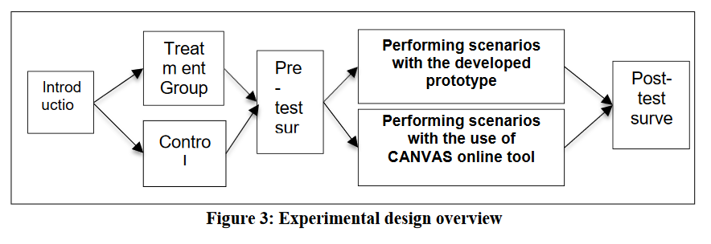
Example case
To what extent do data providers perceive that the availability of control mechanisms (i.e., smart contracts and certification) enhance data sovereignty for data sharing in a meta-platform?
H1: Availability of smart contracts positively influence data sovereignty by enabling a) data ownership and b) control over data for data providers.
H2: Availability of certification positively influences data sovereignty by a) ensuring security, b) clarifying responsibility, and c) adhering to relevant compliance.
Experimental design:
Video explanation
Prototype exploration, depends on the scenario
Questionnaire (e.g., I believe the meta-platform enables sovereignty for the sensitive data that I would share.
What would be threats to internal validity (=causal claims) in this experiment?
Scenario 1 SC = ✓ ; C = ✓
Prototype v.1
Introduction
Video explanation
Questionnaire
Scenario 2 SC = ✗ ; C = ✓
Prototype v.2
Scenario 3 SC = ✓ ; C = ✗
Prototype v.3
Scenario 4 SC = ✗ ; C = ✗
Prototype v.4

Slide 18
How to deal with disturbing factors that are external?
E.g. experience with data sharing
Make disturbing factors constant
e.g. limit to novice users
→ limited external validity
Systematic variation of disturbing factors
disturbing factor as a variable; sampling quota
→ insight in interaction between independent variables

Slide 19
To do before Monday 27 Nov
Read S&B: Ch 5,6,11
Weekly assignment (deadline 18 Nov)
Monday: Wrap-up module 2 & 3
Q&A
Generic feedback
Quizzes

